Slide 1



Sales Analysis
Of
Vrinda
Store
Presented By
Bigyandutt Panda

Slide 2


Objective
Vrinda store wants to create an Annual sales report for 2023.
So That Vrinda can understand thier Customer base and grow more in 2024.

Slide 3






Sales vs Order:
The highest sales of ₹1,928,066 were recorded in March, accompanied by 2,819 orders.
November had the lowest sales of ₹1,615,356 with 2,384 orders.
Gender vs Order Amount:
Women's orders accounted for ₹13,562,773 (64.05%), surpassing men's orders at ₹7,613,604 (35.95%).
Order Status vs Order:
Majority of orders were delivered (28,641), followed by returns (1,045), cancellations (844), and refunds (517).
Findings

Slide 4

Findings
Top 10 States in Ordering:
Maharashtra led in order amount with ₹2,990,221, followed by Karnataka (₹2,646,358) and Uttar Pradesh (₹2,104,659).
Channels vs State:
Amazon had the highest order count with 11,016, followed by Myntra (7,254) and Flipkart (6,703).
Age Group vs Gender:
Women dominated order placements across all age groups.
Order vs Channel in Percentage:
Amazon consistently held the highest percentage of orders, followed by Myntra and Flipkart.

Slide 5


Suggestions
Leverage Success:
Identify factors behind March's high sales for replication.
Target Male Customers:
Implement targeted marketing campaigns to increase male order amounts.
Reduce Cancellations and Returns:
Minimize cancellations, refunds, and returns through quality improvement and enhanced customer support.

Slide 6



Suggestions
Focus on Top Ordering States:
Enhance customer satisfaction and loyalty in Maharashtra, Karnataka, and Uttar Pradesh.
Optimize Channel Performance:
Allocate resources based on channel contributions, with a focus on Amazon, Myntra, and Flipkart.
Foster Innovation and Agility:
Encourage innovation, provide training, and promote data-driven decision-making.

Slide 7
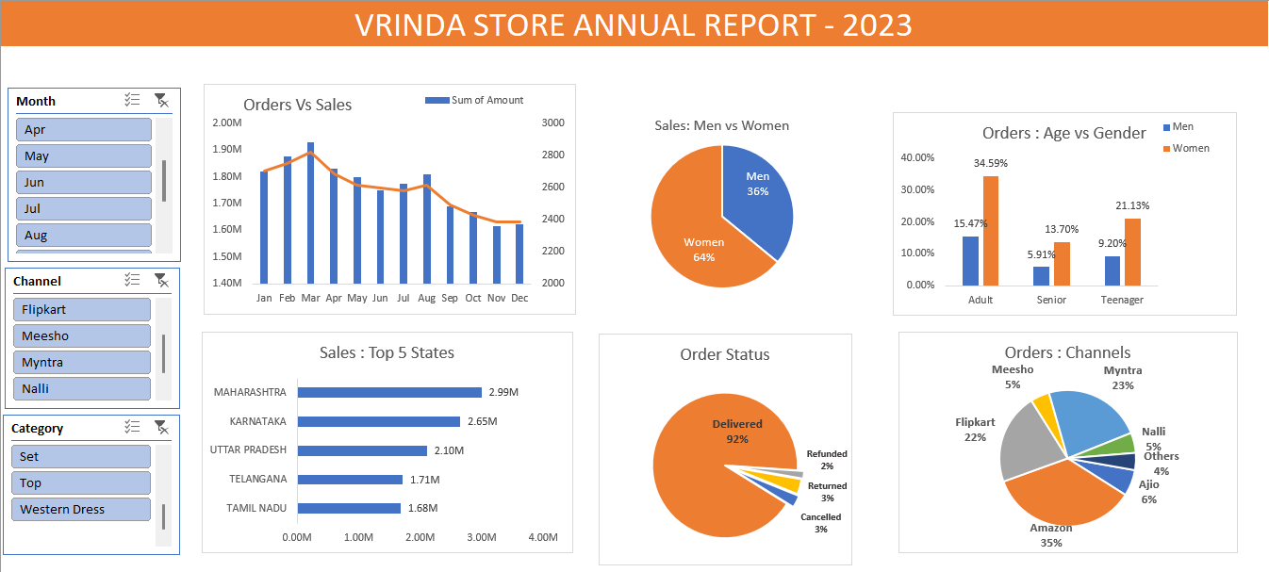
Annual Report

Slide 8








Thank
You
Excel project
By:-
BIGYANDUTT PANDA

